Slide 1


© Students of History - https://www.teacherspayteachers.com/Store/Students-Of-History

Slide 2

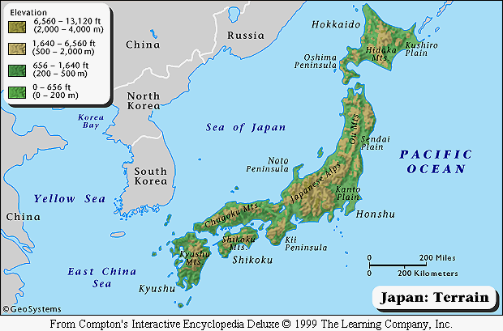
Nippon -- “Land of the Rising Sun”
Notes:
The next couple of slides are a comparison of the countries that we will be visiting. Notice how small all are compared to China.

Slide 3
Japan is very mountainous and therefore has very little arable land.
Notes:
The next couple of slides are a comparison of the countries that we will be visiting. Notice how small all are compared to China.

Slide 4
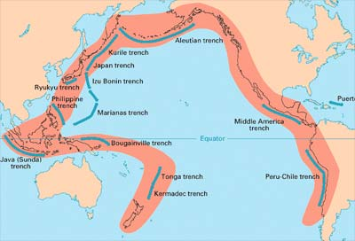
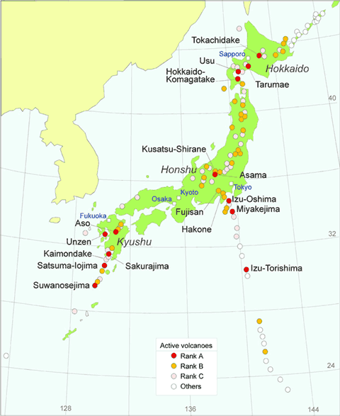
There are many volcanoes on Japan’s four major islands.
Japan is an
archipelago: a chain of
islands

Slide 5
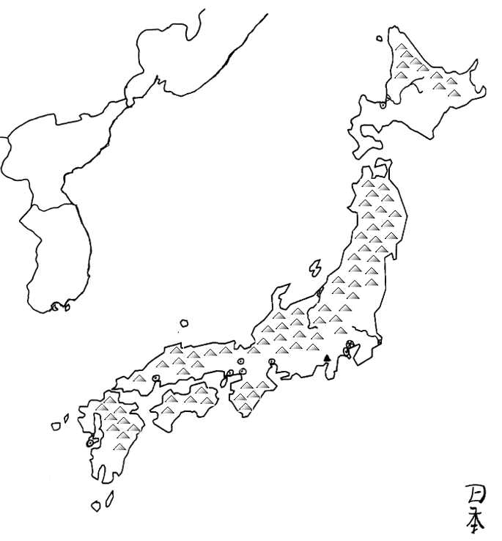
Ishikari R.
Bodies
of
Water
Sea of Japan
Shinano R.
Tone R.
Korean Straits
Pacific Ocean
Inland Sea

Slide 6
Mountains
And
Peaks
Kitani Mts.
Kitakami Mts.
Mikuni Mts.
Chugoku Mts.
Kyushu Mts.
Mt. Fuji

Slide 7
Plains
Ishikari Plain
Kanto Plain
Nobi Plain
Osaka Plain

Slide 8
Russia
Countries
China
N. Korea
S. Korea

Slide 9
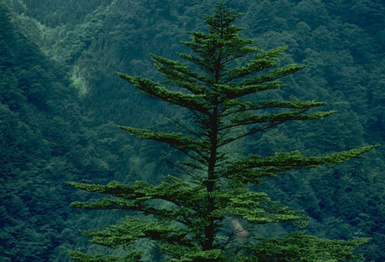
Very Mountainous:
Little Arable Land

Slide 10
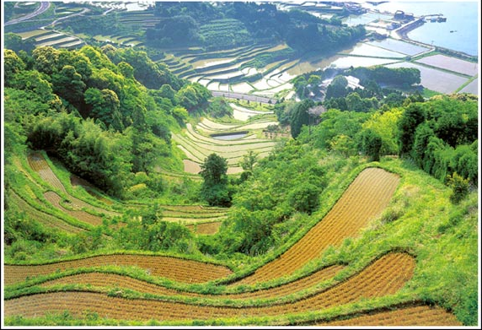
Terrace Farming of Rice

Slide 11
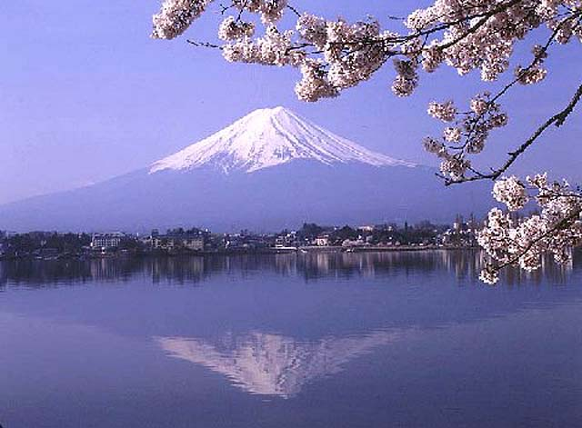
Mt. Fuji is the highest point in Japan.

Slide 12

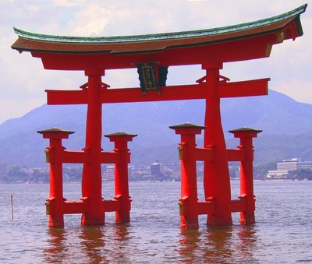

Slide 13
Shinto
An indigenous religion
Places an emphasis on nature
Earth, Sky, Sea, Sun, Moon and Stars are worshipped as gods

Slide 14
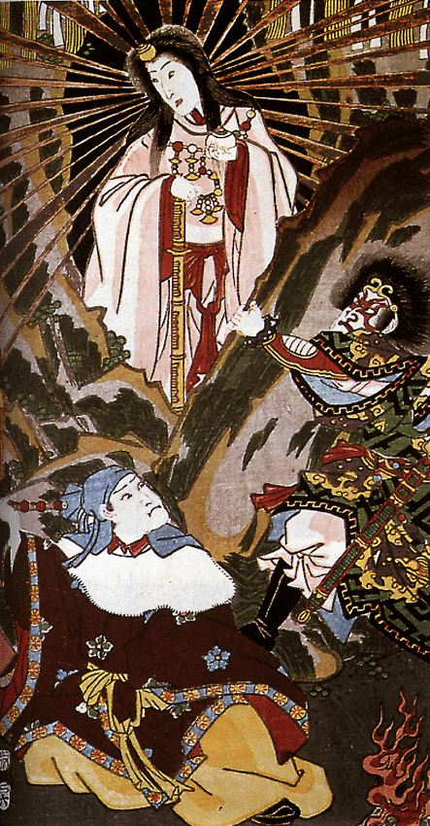
Amaterasu : Sun Goddess

Slide 15

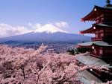
Mt. Fuji: Mountain Goddess

Slide 16
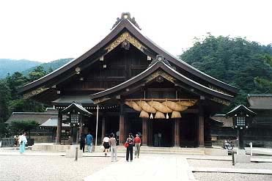
Shinto Temple – “worship hall”

Slide 17
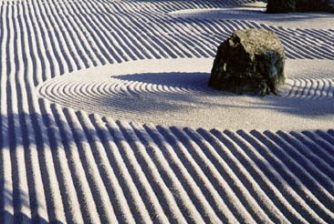
Buddhism in Japan
Korean travelers brought Buddhism to Japan
Buddhist ideas and worship spread throughout Japan
Japan did not give up its Shinto beliefs
Buddhist and Shinto beliefs merged together, Zen Buddhism
Zen garden

Slide 18
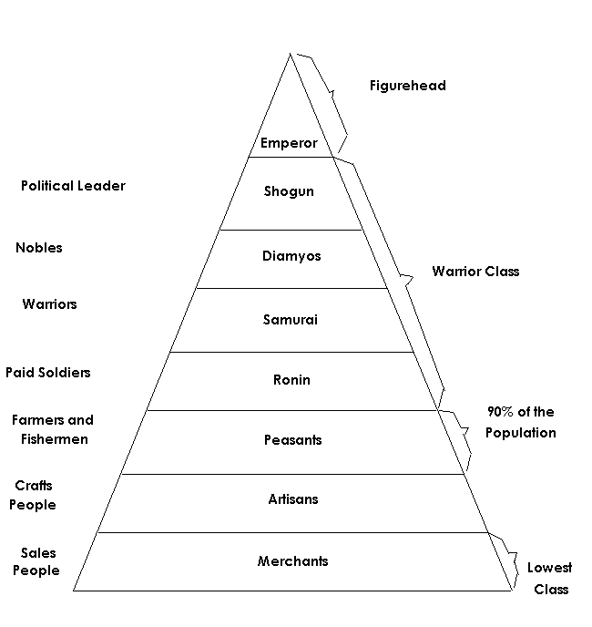
The emperor
reigned, but did not always rule!
Feudal Society

Slide 19
Code of Bushido: A code of behavior that every samurai must follow
Code of Chivalry in Europe
Justice
Loyalty
Defense
Courage
Faith
Humility
Nobility
Fidelity (loyalty)
Politeness
Simplicity

Slide 20
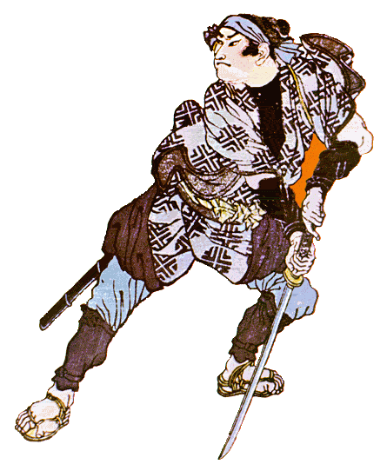
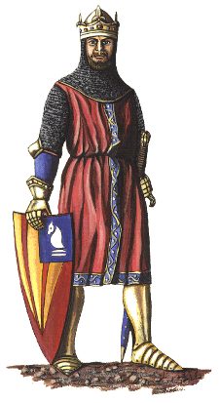
Medieval Warriors
vs.
Samurai Warrior
European knight

Slide 21
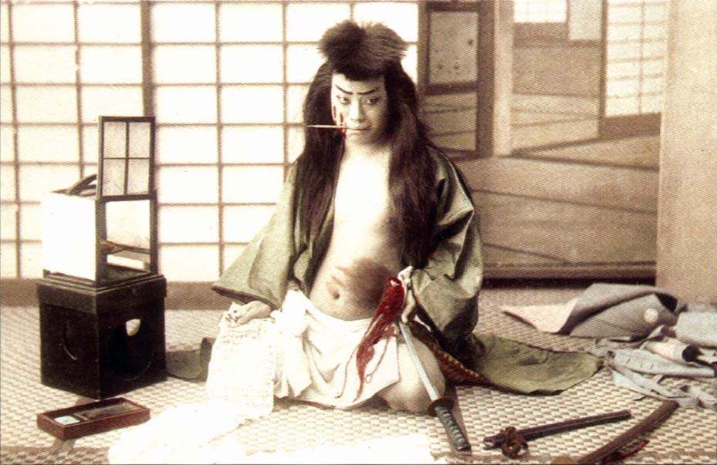
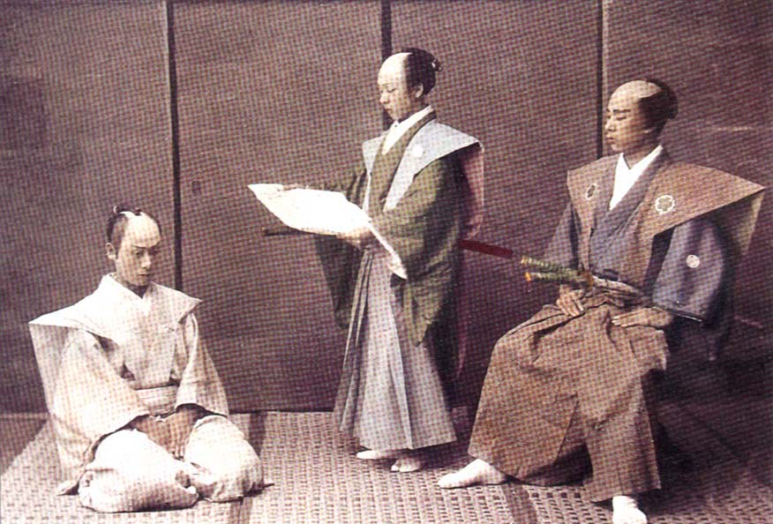
Seppuku:
Ritual Suicide by disembowelment
It is honorable to die in this way.
Kaishaku – his “seconds”

Slide 22
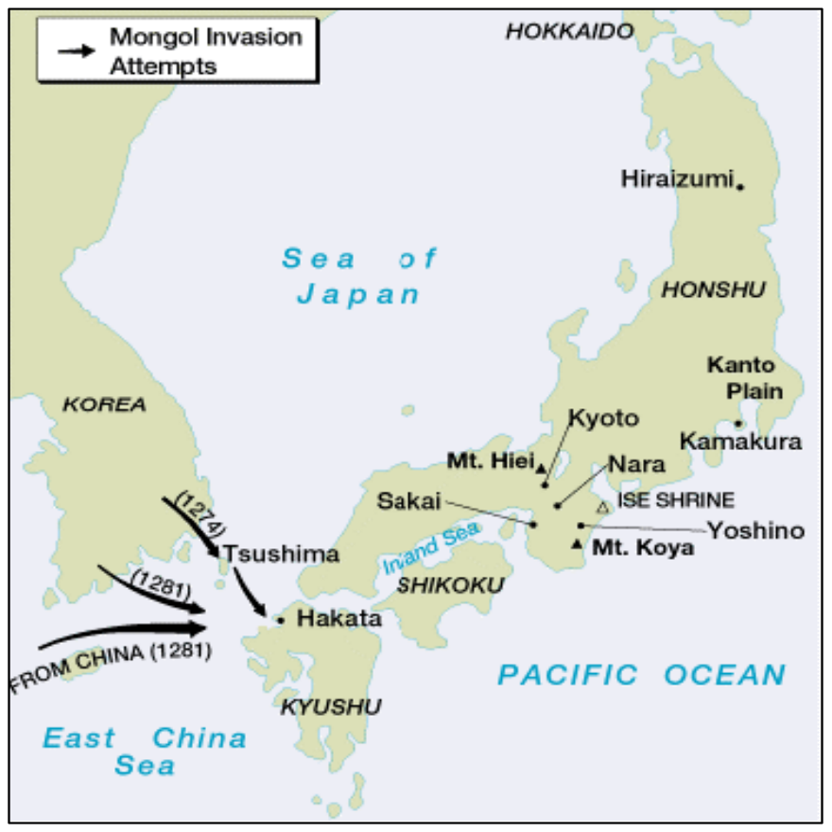
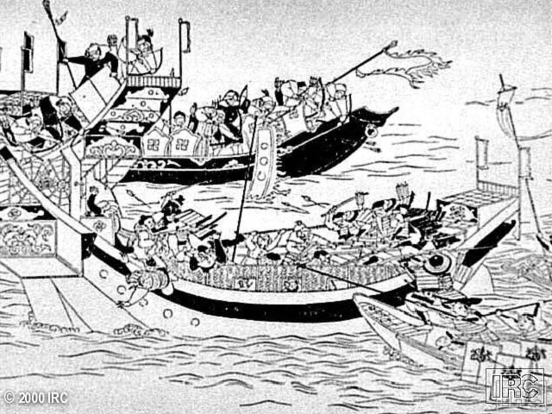
Mongols Attempt to Invade Japan
4,400 ships and 140,000 Mongol men, but kamikaze winds stopped them.

Slide 23

